Slide 1

MA2011 MECHATRONICS SYSTEMS INTERFACING
Lecture 1
Prof. Cai Yiyu
College of Engineering
School of Mechanical and Aerospace Engineering

Slide 2
WHAT IS MECHATRONICS?
First introduced in 1969 by Yasakawa Electric, Japan

Slide 3
MECHATRONICS DEFINITIONS BY BOOKS
Applied Mechatronics (Samili and Mrad)
“Interdisciplinary engineering field comprising the design and development of smart electromechanical systems."
Design with Microprocessors for Mechanical Engineers (Stiffler)
“Science that integrates mechanical devices with electronic controls"
Introduction to Mechatronics & Measurement Systems
(Alciatore & Histand)
“The interdisciplinary field of engineering dealing with the design of products whose function relies on the integration of mechanical and electronic components coordinated by a control architecture."

Slide 4
MECHATRONICS DEFINITIONS BY BOOKS
Mechatronics (Harshama, Tomizuka & Fukuda)
“The synergistic integration of mechanical engineering with electronics and electrical systems with intelligent computer control in the design and manufacture of industrial products, processes, and operations."
Mechatronics - A Foundation Course (de Silva)
“The synergistic application of mechanics, electronics, and computer engineering in the development of electromechanical products and systems through an integrated design approach."
Mechatronics - Electromechanics and Contromechanics (Miu)
“Crossdisciplinary [field] ... that simultaneously involves mechanics, electronics, and control of computer-integrated electromechanical systems"

Slide 5
MECHATRONICS DEFINITIONS BY BOOKS
Mechatronics - Electronic Control Systems in
Mechanical Engineering (Bolton)
“Integration of electronics, control engineering and mechanical engineering"
Mechatronics - Electronics in Products and Processes
(Bradley, et al)
“An integrating theme within the design process [combining] electronic engineering, computing and mechanical engineering"

Slide 6
MECHATRONICS DEFINITIONS BY BOOKS
Mechatronics Engineering
“Preplanned activity to consider electrical, mechanical, and software constraints over the product life cycle in a simultaneous manner early in the development process"
Mechatronics System Design (Shetty and Kolk)
“Methodology used for the optimal design of electromechanical products”
Mechatronics - Mechanical System Interfacing
(Auslander and Kempf)
“The application of complex decision making to the operation of physical systems"

Slide 7
MECHATRONICS EDUCATION IN DIFFERENT UNIVERSITIES
University Of Washington (US)
“The integrated study of the design of systems and products in which computation, mechanization, actuation, sensing, and control are designed together to achieve improved product quality and performance."
University Of California At Berkeley (US)
“A flexible, multi-technological approach in the integration of Mechanical Engineering, Computer Engineering, Electronics, and Information Sciences"
Rensselaer Polytechnic Institute (US)
“The synergistic combination of mechanical engineering, electronics, control systems and computers, all integrated through the design process."

Slide 8
MECHATRONICS EDUCATION IN DIFFERENT UNIVERSITIES
Loughborough University (UK)
"Mechatronics is a design philosophy that utilizes a synergistic integration of Mechanics, Electronics and Computer Technology (or IT) to produce enhanced products, processes or systems."
Johannes Kepler University Linz (AUSTRIA)
“Technical systems operating mechanically with respect to at least some kernel functions but with more or less electronics supporting the mechanical parts decisively"

Slide 9
MECHATRONICS LEARNING RESOURCES
Mechatronics (Journal)
“The synergistic combination of precision mechanical engineering, electronic control and systems thinking in the design of products and manufacturing processes"
ME Magazine
“The synergistic use of precision engineering, control theory, computer science, and sensor and actuator technology to design improved products and processes" "simply the application of the latest techniques in precision mechanical engineering, controls theory, computer science, and electronics to the design process to create more functional and adaptable products."
Industrial Research and Development Advisory
Committee of the European Community
“Synergistic combination of precision engineering, electronic control and systems thinking in the design of products and manufacturing processes."

Slide 10
WHAT IS A MECHATRONICS SYSTEM?

Slide 11
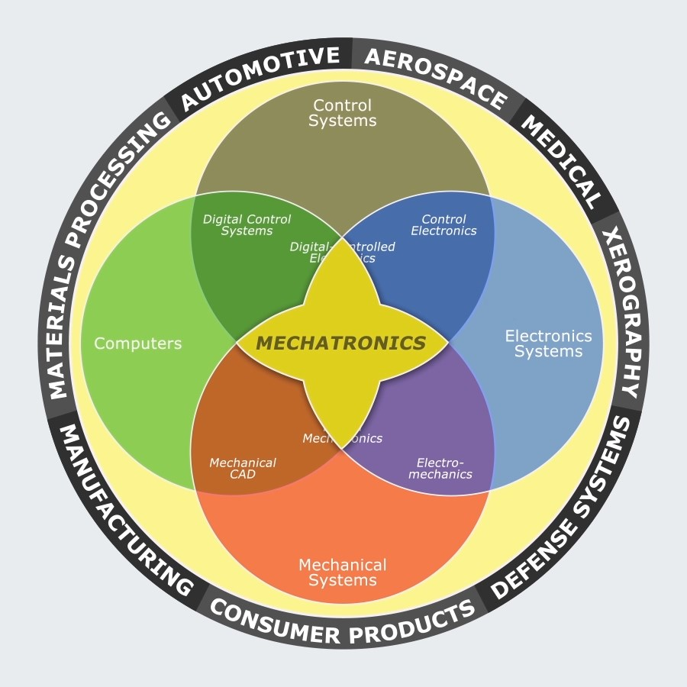
MECHATRONICS SYSTEM
Click image to play video

Slide 12
PART 1: SYSTEM RESPONSE
This lecture explains how a physical system
responds to its dynamics inputs.

Slide 13
LEARNING GOALS
1
Three main characteristics of a good measurement system of Amplitude Linearity, Phase Linearity, and Adequate Bandwidth.
2
Fourier series representation of a signal and its applications.
3
Relationship between an instrument's bandwidth and spectra of its input and output signals.
4
Dynamic response of zero-, first-, and second-order systems.
5
System response to step and sinusoidal inputs.
6
Analogies among mechanical, electrical and hydraulic systems.

Slide 14
PART 1.1 MEASUREMENT SYSTEMS

Slide 15
MEASUREMENT SYSTEMS - COMPONENTS
A measurement system
(integral part of mechatronics systems)
consists of 3 components:
A transducer
a device usually converts a physical quantity into a time-varying voltage (called analog signal)
A signal processor
a device can modify the analog signal
A recorder
a device displays or records the signal.
transducer
signal processor
recorder

Slide 16
MEASUREMENT SYSTEMS - COMPONENTS
INPUT
Physical quantity to be measured is called input to a measurement system.
OUTPUT
Transducer transforms the input into a form compatible with the processor to be processed then becomes the output of a measurement system.
DIFFERENCE
Usually, the input is different from the output of a measurement system.
CHARACTERISATION
A good measurement system is characterised by: phase linearity, amplitude linearity, and adequate bandwidth.

Slide 17
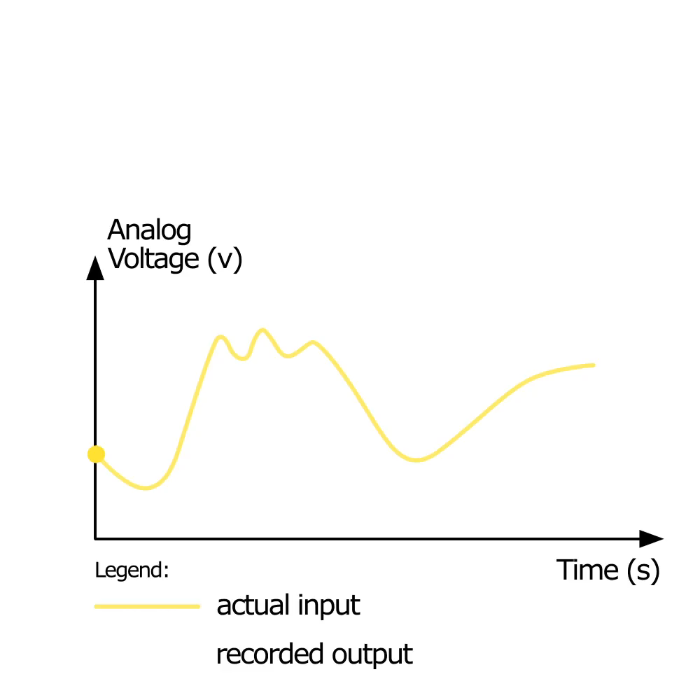
MEASUREMENT SYSTEMS - DIFFERENCES
actual
input
signal processor
recorder
output
Click image to play video

Slide 18
PART 1.2 AMPLITUDE LINEARITY

Slide 19
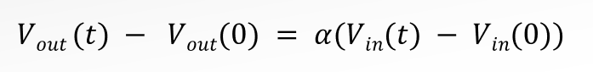
AMPLITUDE LINEARITY
The output always changes with the same factor times by the
change in the input, i.e.,
where α is the proportional constant (gain).

Slide 20
AMPLITUDE LINEARITY - REMARKS
1
If not amplitude linearity, it is difficult to interpret the output
2
A measurement system usually satisfies amplitude linearity over a limited range of input amplitudes (e.g. spring)
3
Linear response of a measurement system usually holds for a limited range of the input rate
4
An ideal measurement system exhibits amplitude linearity for any input amplitude and input rate.

Slide 21
AMPLITUDE LINEARITY
Linear

Slide 22
AMPLITUDE LINEARITY
Nonlinear

Slide 23
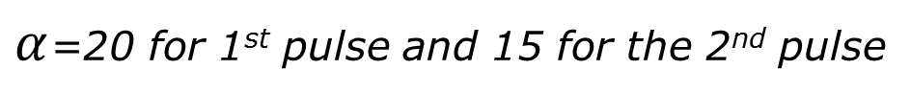
AMPLITUDE LINEARITY
Nonlinear
$α$=20 for 1st pulse and 15 for the 2nd pulse

Slide 24
PART 1.3 FOURIER SERIES REPRESENTATION OF SIGNALS

Slide 25
FOURIER SERIES REPRESENTATION OF SIGNALS
1
To study bandwidth and phase linearity (applied to frequency components of an input signal), it is necessary to review Fourier series representation of a signal.
2
Any periodical waveform can be represented as an infinite series of sine and cosine waveforms of different amplitudes and frequencies.
3
Summing up this infinite series gives the original periodical waveform.
4
Practically, a finite number of the sine and cosine waveforms can adequately represent a periodical waveform.

Slide 26
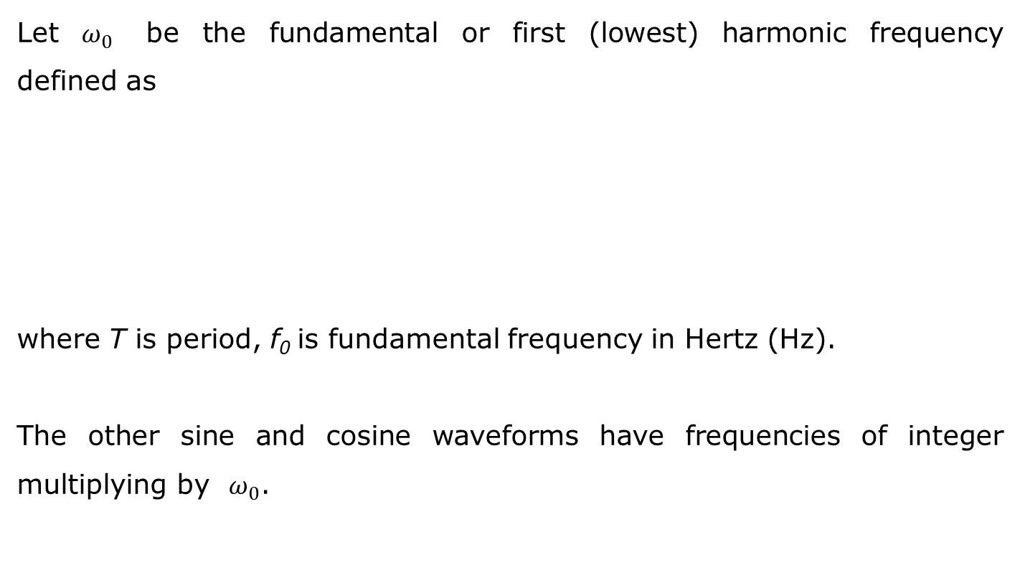
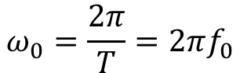
FOURIER SERIES REPRESENTATION OF SIGNALS
Let $ω_{0}$ be the fundamental or first (lowest) harmonic frequency defined as
where T is period, f₀ is fundamental frequency in Hertz (Hz).
The other sine and cosine waveforms have frequencies of integer multiplying by $ω_{0}$.
$$ω_{0}=\frac{2π}{T}=2πf_{0}$$
1

Slide 27
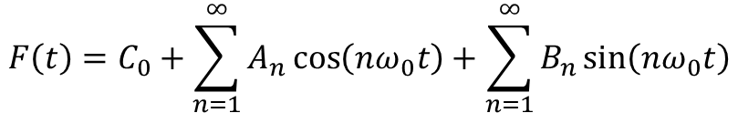
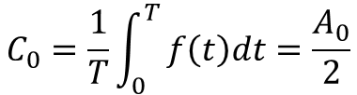
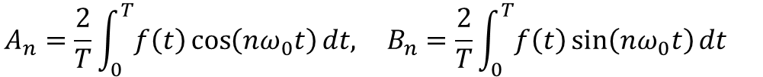
FOURIER SERIES REPRESENTATION OF SIGNALS
The Fourier series representation of a periodical waveform f(t) is
$$F\left(t\right)=C_{0}+\sum_{n=1}^{∞}{A_{n}\cos\left(nω_{0}t\right)+\sum_{n=1}^{∞}{B_{n}\sin\left(nω_{0}t\right)}}$$
2
where C₀ is the DC component of the signal, A_{n} and B_{n} are coefficients. They are given by
$$A_{n}=\frac{2}{T}\int_{0}^{T}{f\left(t\right)\cos\left(nω_{0}t\right)dt,} B_{n}=\frac{2}{T}\int_{0}^{T}{f\left(t\right)\sin\left(nω_{0}t\right)dt }$$
3
$$C_{0}=\frac{1}{T}\int_{0}^{T}{f\left(t\right)dt=\frac{A_{0}}{2}}$$
Note: C₀ is the average value of the waveform over its period.

Slide 28
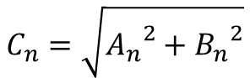
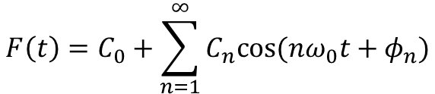
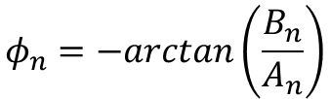
FOURIER SERIES REPRESENTATION OF SIGNALS
Define
$$C_{n}=\sqrt{{A_{n}}^{2}+{B_{n}}^{2}}$$
4
$$φ_{n}=−arctan\left(\frac{B_{n}}{A_{n}}\right)$$
Then
$$F\left(t\right)=C_{0}+\sum_{n=1}^{∞}{C_{n}cos⁡(nω_{0}t+φ_{n})}$$
5
That is, a period waveform can be represented by an infinite series of cosine of single amplitude and phase

Slide 29
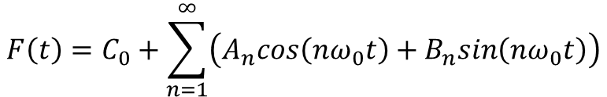
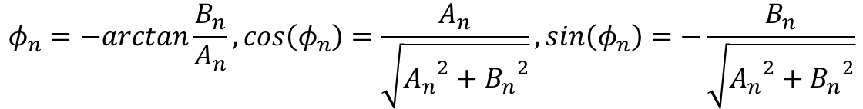
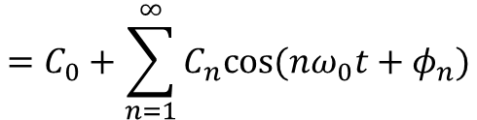
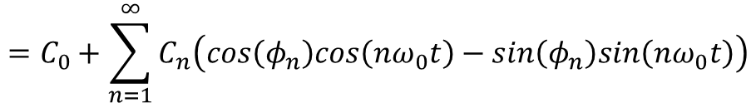
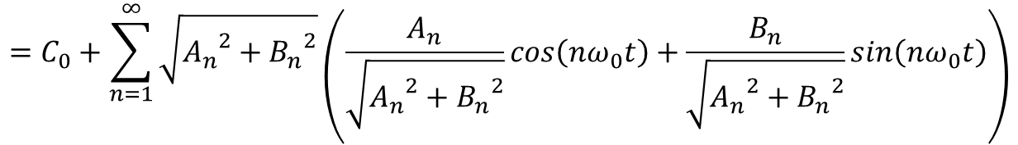
FOURIER SERIES REPRESENTATION OF SIGNALS
$$F\left(t\right)=C_{0}+\sum_{n=1}^{∞}{\left(A_{n}cos\left(nω_{0}t\right)+B_{n}sin\left(nω_{0}t\right)\right)}$$
$$=C_{0}+\sum_{n=1}^{∞}{\sqrt{{A_{n}}^{2}+{B_{n}}^{2}}}\left(\frac{A_{n}}{\sqrt{{A_{n}}^{2}+{B_{n}}^{2}}}cos\left(nω_{0}t\right)+\frac{B_{n}}{\sqrt{{A_{n}}^{2}+{B_{n}}^{2}}}sin\left(nω_{0}t\right)\right)$$
$$=C_{0}+\sum_{n=1}^{∞}{C_{n}\left(cos\left(φ_{n}\right)cos\left(nω_{0}t\right)−sin\left(φ_{n}\right)sin\left(nω_{0}t\right)\right)}$$
$$=C_{0}+\sum_{n=1}^{∞}{C_{n}cos⁡(nω_{0}t+φ_{n})}$$
$$φ_{n}=−arctan\frac{B_{n}}{A_{n}},cos\left(φ_{n}\right)=\frac{A_{n}}{\sqrt{{A_{n}}^{2}+{B_{n}}^{2}}},sin\left(φ_{n}\right)=−\frac{B_{n}}{\sqrt{{A_{n}}^{2}+{B_{n}}^{2}}}$$

Slide 30
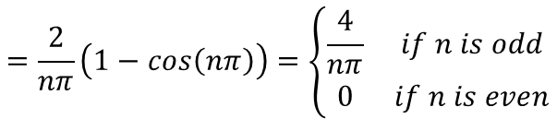
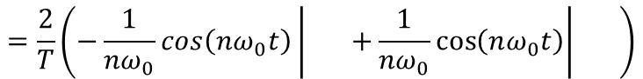
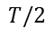
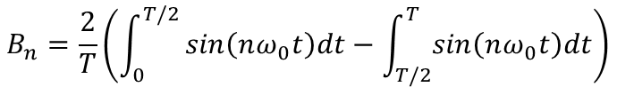
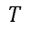
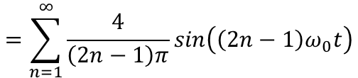
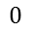
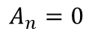
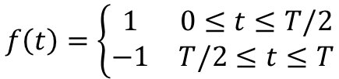
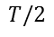
FOURIER SERIES REPRESENTATION OF SIGNALS
Example: Square waveform with period T
$$f(t)$$
$$1$$
$$f\left(t\right)=\left\{\begin{matrix}1 & 0≤t≤T/2 \\ −1 & T/2≤t≤T\end{matrix}\right.$$
6
$$t$$
$$T$$
Then
$$A_{n}=0$$
$$B_{n}=\frac{2}{T}\left(\int_{0}^{T/2}{sin\left(nω_{0}t\right)dt−\int_{T/2}^{T}{sin\left(nω_{0}t\right)dt}}\right)$$
$$=\frac{2}{T}\left(−\frac{1}{nω_{0}}cos\left(nω_{0}t\right)\left| +\frac{1}{nω_{0}}\cos\left(nω_{0}t\right)\right| \right)$$
7
$$T/2$$
$$T$$
$$0$$
$$T/2$$
$$=\frac{2}{nπ}\left(1−cos\left(nπ\right)\right)=\left\{\begin{matrix}\frac{4}{nπ} & if n is odd \\ 0 & if n is even\end{matrix}\right.$$
Therefore
$$F\left(t\right)=\frac{4}{π}\sin\left(ω_{0}t\right)+\frac{4}{3π}\sin\left(3ω_{0}t\right)+\frac{4}{5π}\sin\left({5ω}_{0}t\right)+…$$
8
$$=\sum_{n=1}^{∞}{\frac{4}{\left(2n−1\right)π}sin\left(\left(2n−1\right)ω_{0}t\right)}$$

Slide 31
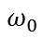
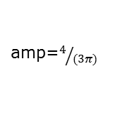
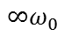
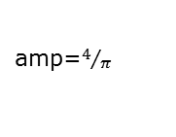
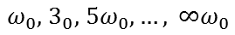
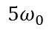
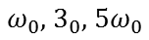
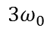
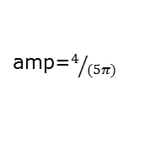
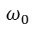
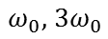
FOURIER SERIES REPRESENTATION OF SIGNALS
$$f(t)$$
$$1$$
$$t$$
$$T$$
individual harmonics
combined harmonics
$$ω_{0}$$
$$ω_{0}$$
amp=$4/π$
$${3ω}_{0}$$
$${ω_{0}\text{,} 3ω}_{0}$$
amp=$4/{(3π)}$
$${5ω}_{0}$$
$${ω_{0}\text{,}{ 3}_{0}\text{,} 5ω}_{0}$$
amp=$4/{(5π)}$
$${∞ω}_{0}$$
amp= 0
$${{ω_{0}\text{,}{ 3}_{0}\text{,} 5ω}_{0}\text{,}…, ∞ω}_{0}$$

Slide 32
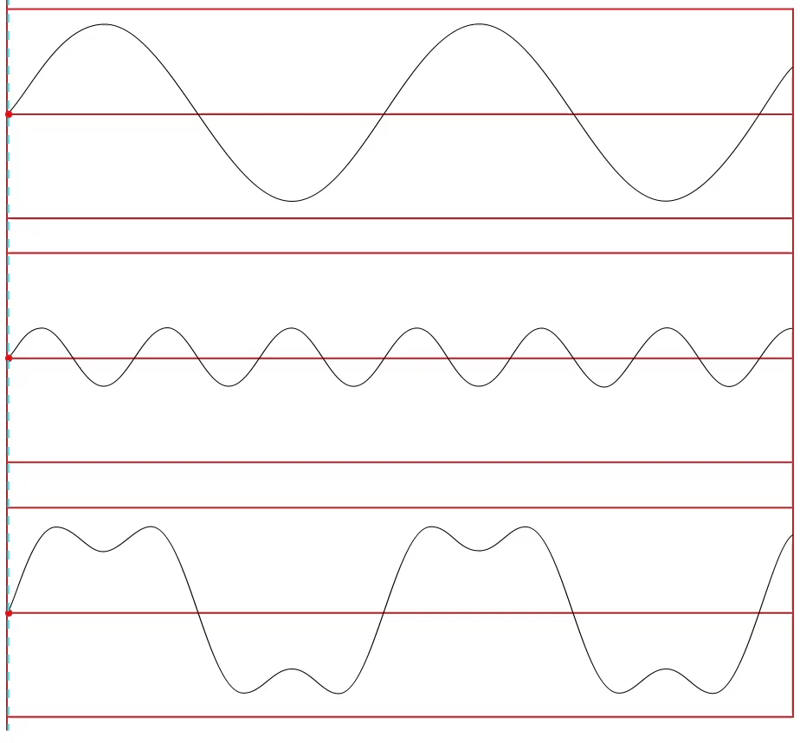
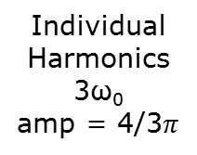
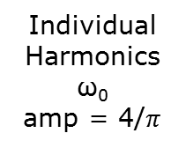
FOURIER SERIES REPRESENTATION OF SIGNALS
Individual
Harmonics
ω₀
amp = 4/$π$
+
Individual
Harmonics
3ω₀
amp = 4/3$π$
=
Combined
Harmonics
ω₀, 3ω₀
Click image to play video

Slide 33
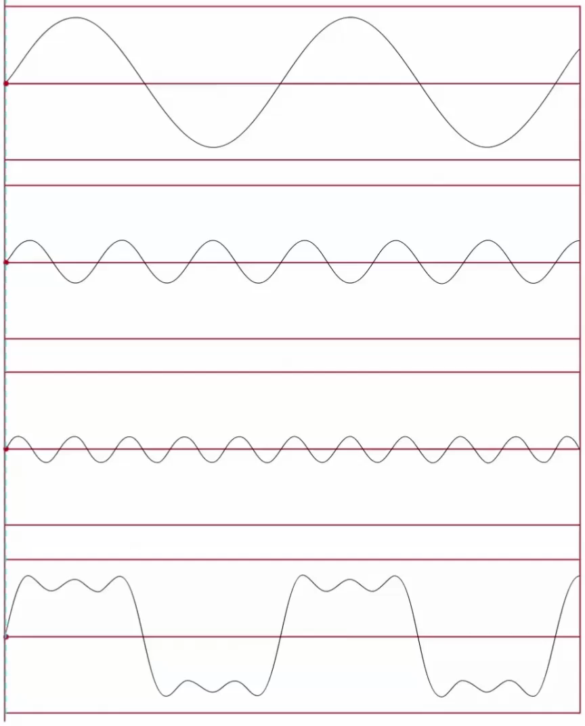
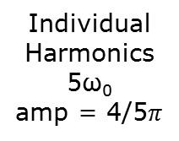
FOURIER SERIES REPRESENTATION OF SIGNALS
Individual
Harmonics
ω₀
amp = 4/$π$
+
Individual
Harmonics
3ω₀
amp = 4/3$π$
+
Individual
Harmonics
5ω₀
amp = 4/5$π$
=
Combined
Harmonics
ω₀, 3ω_{0,} 5ω₀
Click image to play video

Slide 34
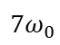
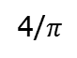
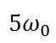
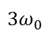
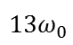
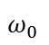
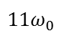


FOURIER SERIES REPRESENTATION OF SIGNALS
Plotting spectrum
When plotting spectrum for a signal represented by a Fourier series, use single-amplitude by equation (5),
signal
time domain
time
$$T$$
$$F\left(t\right)=\frac{4}{π}\sin\left(ω_{0}t\right)+\frac{4}{3π}\sin\left(3ω_{0}t\right)+\frac{4}{5π}\sin\left({5ω}_{0}t\right)+…$$
1.5
4/$π$
spectrum
amplitude
4/$(3π)$
frequency domain
0
$$ω_{0}$$
$${3ω}_{0}$$
$${5ω}_{0}$$
$${7ω}_{0}$$
$${9ω}_{0}$$
$${11ω}_{0}$$
$${13ω}_{0}$$
frequency

Slide 35
PART 1.4 BANDWIDTH AND FREQUENCY RESPONSE

Slide 36
BANDWIDTH AND FREQuENCY RESPONSE
1
It is important to estimate spectrum of a signal when choosing a measurement system
2
Ideal measurement system replicates all frequency components of an input signal
3
Practical measurement system has limitation in reproducing all frequencies.

Slide 37

BANDWIDTH AND FREQuENCY RESPONSE
Common scale used to measure fidelity of a measurement system’s reproduction at different frequencies is the decibel scale:
where A_{in} and A_{out} are input and output amplitudes of a harmonic.
$$dB={20log}_{10}\left(\frac{A_{out}}{A_{in}}\right)$$
9

Slide 38



BANDWIDTH AND FREQuENCY RESPONSE
Frequency response curve or Bode plot plots A_{out}/A_{in} vs. input frequency
amplitude ratio $\left(A_{out}/A_{in}\right)$
1.000
0.707
(-3dB)
bandwidth
$$ω_{L}$$
$$ω_{H}$$
frequency

Slide 39



BANDWIDTH AND FREQuENCY RESPONSE
Bandwidth is the range of the frequencies where the input is not attenuated by more than -3dB, i.e.
where $ωL$ and $ωH$ called corner or cut-off frequencies.
Why -3dB? This comes from half of output power over input power,
i.e.,
So, bandwidth is proportional to fidelity of a measurement system.
$$\text{bandwitdh}\text{ = }ωL to ωH$$
10
$$\frac{1}{2}= \frac{P_{out}}{P_{in}}={\left(\frac{A_{out}}{A_{in}}\right)}^{2}$$
$$⇒\frac{A_{out}}{A_{in}}=\sqrt{1/2}⇒dB={20log}_{10}\sqrt{1/2}≈−3dB$$
11

Slide 40


BANDWIDTH AND FREQuENCY RESPONSE
Example: Calculating output amplitude $A_{i}^{′}$ given a measurement frequency response curve: -the input signal spectrum is
the output amplitude $A_{i}^{′}$ is calculated as
$$V_{in}\left(t\right)= A_{1}\sin\left(ω_{0}t\right)+A_{2}\sin\left(2ω_{0}t\right)+A_{3}\sin\left(3ω_{0}t\right)+…$$
12
$$A_{i}^{′}=\left(\frac{A_{out}}{A_{in}}\right)A_{i}$$
13

Slide 41















BANDWIDTH AND Frequency RESPONSE
Example: Calculating output amplitude $A_{i}^{′}$ given a measurement frequency response curve: -the input signal spectrum is
the output amplitude $A_{i}^{′}$ is calculated as
$$V_{in}\left(t\right)= A_{1}\sin\left(ω_{0}t\right)+A_{2}\sin\left(2ω_{0}t\right)+A_{3}\sin\left(3ω_{0}t\right)+…$$
12
$$A_{i}^{′}=\left(\frac{A_{out}}{A_{in}}\right)A_{i}$$
$$A_{in}$$
input signal spectrum
13
$$A_{3}$$
$$A_{2}$$
$$A_{1}$$
$$ω_{0}$$
$${2ω}_{0}$$
$${3ω}_{0}$$
10$ω_{0}$
frequency
$$A_{out}/A_{in}$$
measurement system
frequency response
$$1$$
$$0.5$$
$$0.25$$
$$A_{out}$$
output signal
spectrum
frequency
$$A3$$
$$0.25 A2$$
frequency

